Slide 1
Capstone Project
Credit Card Default Prediction Name: Md Sohail Tanveer

Slide 2
Business Context
This project is aimed at predicting the case of customer default payments in Taiwan.
From the perspective of risk management, the result of predictive accuracy of the estimated probability of default will be more valuable than the binary result of classification - credible or not credible clients.
We can use the K-S chart to evaluate which customers will default on their credit card payments

Slide 3
Main Libraries Used
pandas for data manipulation and aggregation
Matplotlib, seaborn for visualization and behavior with respect to a target variable
NumPy for computationally efficient operation
Scikitlearn for model training, model optimization, and metrics calculations

Slide 4
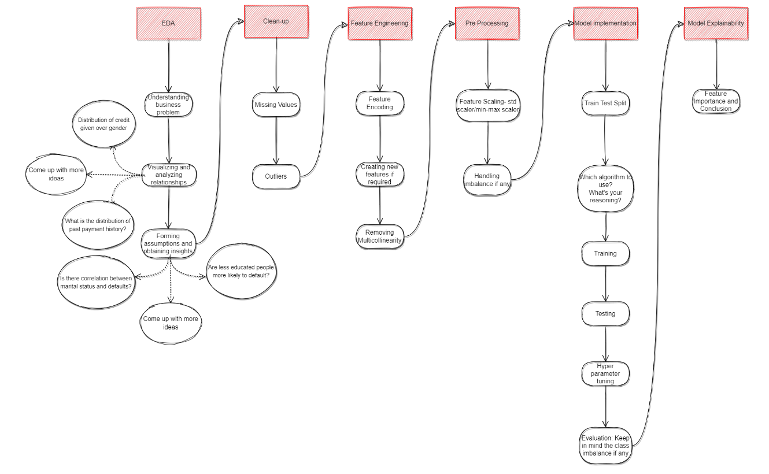
Project Architecture

Slide 5
Table of Content
Know Your Data
Understand Your Variable
Exploratory Data Analysis
Feature Engineering
Model Implementation
Model Explainability
Conclusion

Slide 6
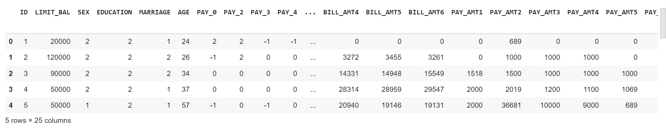
1. Know Your Data
Import different important libraries and then load your dataset.
The data set preview is given below.
This dataset has 30000 observations and 25 columns. The target variable is the default payment next month column.

Slide 7
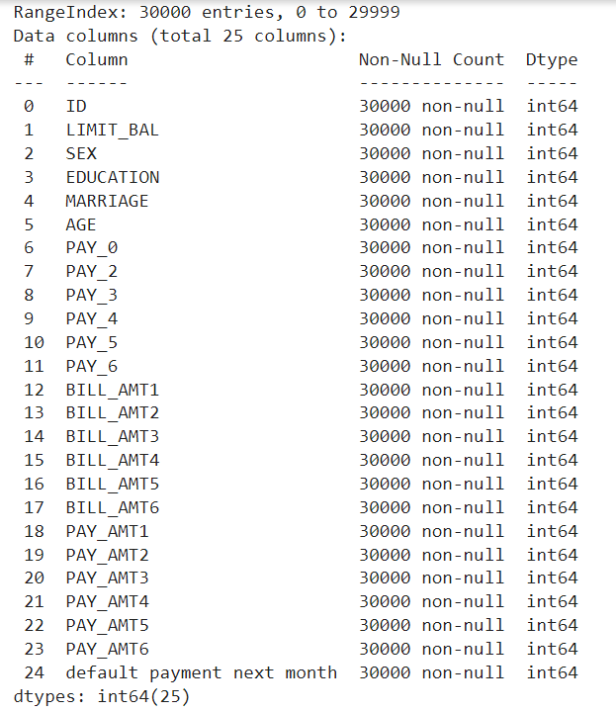
Dataset Information
This dataset has 24 independent features and one target variable.
All the columns are integer types.
There are no missing or NULL values in the dataset.
The dataset is ready for Exploratory data analysis.
Also there is no duplicated value in the dataset.

Slide 8
2. Understand Your Variable
The 24 independent variables are 'ID', 'LIMIT_BAL', 'SEX', 'EDUCATION', 'MARRIAGE', 'AGE', 'PAY_0', 'PAY_2', 'PAY_3', 'PAY_4', 'PAY_5', 'PAY_6', 'BILL_AMT1', 'BILL_AMT2', 'BILL_AMT3', 'BILL_AMT4', 'BILL_AMT5', 'BILL_AMT6', 'PAY_AMT1', 'PAY_AMT2', 'PAY_AMT3', 'PAY_AMT4', 'PAY_AMT5', 'PAY_AMT6’.
The target variable is 'default payment next month’.

Slide 9
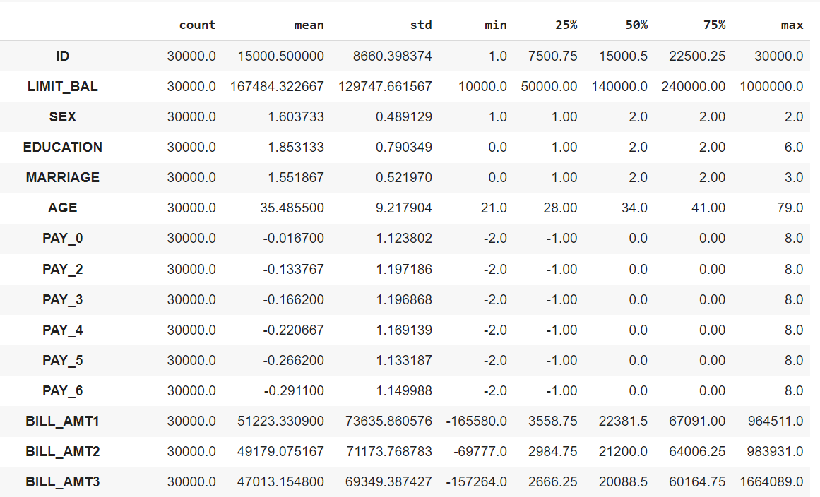
Statistical Description

Slide 10
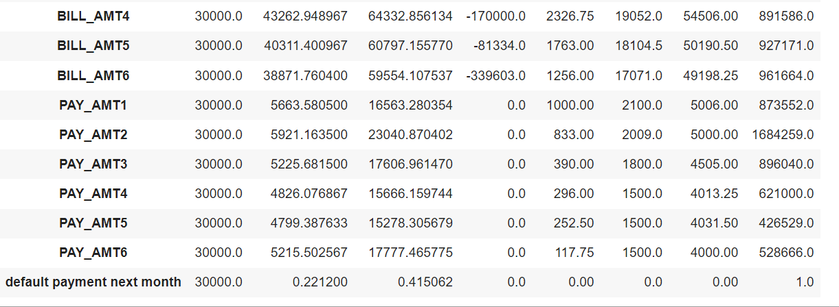
Statistically the data is correct and ready for EDA

Slide 11
Variable Description
default payment next month (Yes = 1, No = 0), as the target variable.
The other 24 independent variables are:
X1: Amount of the given credit (NT dollar): it includes both the individual consumer credit and his/her family (supplementary) credit.
X2: Gender (1 = male; 2 = female).
X3: Education (1 = graduate school; 2 = university; 3 = high school; 4 = others).
X4: Marital status (1 = married; 2 = single; 3 = others).
X5: Age (year).

Slide 12
X6 - X11: History of past payments. We tracked the past monthly payment records (from April to September 2005) as follows:
X6 = the repayment status in September 2005;
X7 = the repayment status in August 2005; . . .;
X11 = the repayment status in April 2005.
The measurement scale for the repayment status is: -1 = pay duly; 1 = payment delay for one month; 2 = payment delay for two months; . . .; 8 = payment delay for eight months; 9 = payment delay for nine months and above.

Slide 13
X12-X17: Amount of bill statement (NT dollar).
X12 = amount of bill statement in September 2005;
X13 = amount of bill statement in August 2005; ………………….. . .;
X17 = amount of bill statement in April 2005.
X18-X23: Amount of previous payment (NT dollar).
X18 = amount paid in September 2005;
X19 = amount paid in August 2005; ……………… .;
X23 = amount paid in April 2005.

Slide 14
3. EDA(Exploratory Data Analysis)
An EDA is a thorough examination meant to uncover the underlying structure of a data set and is important for a company because it exposes trends, patterns, and relationships that are not readily apparent.
Renaming variable Pay_0 with Pay_1 and default payment next month with default_payment_next_month.
let’s check the distribution of each variable with the target variable.

Slide 15
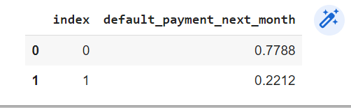
Target variable
Our target variable is default_payment_next_month. (Yes = 1, No = 0)
Let’s check the value count of each unique value.
We can clearly see that more than 22 percent of customers have default payments next month. And it’s a huge proportion of the credit card business.

Slide 16
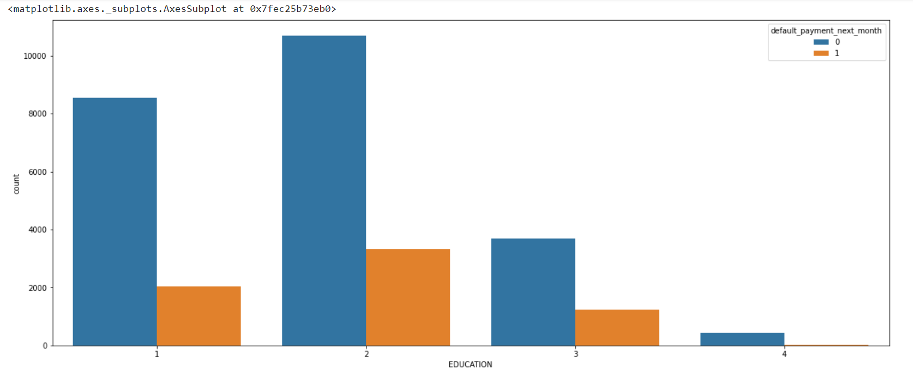
Education v/s Target Variable
1 = graduate school; 2 = university; 3 = high school; 4= others
The proportion of defaulters is similar in every educational background.

Slide 17
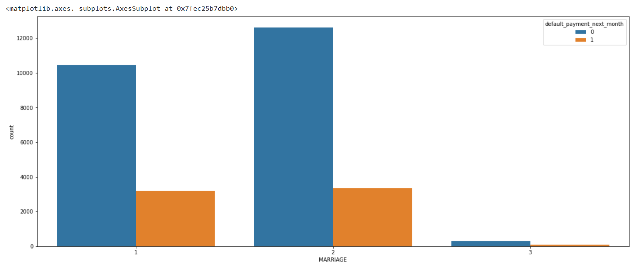
Marriage v/s Target Variable
1 = married; 2 = single; 3 = others
The ratio of defaulter are equal in all marriage category.

Slide 18
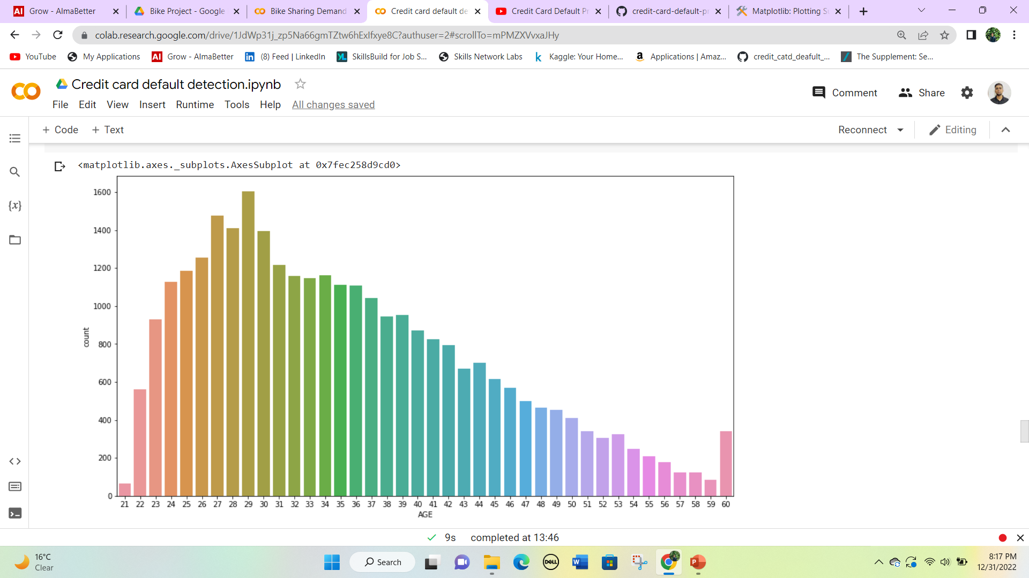
Age v/s Target Variable
We can see more credit cards holder aged between 26-30 years old.
Age above 60 years old rarely uses credit cards.

Slide 19
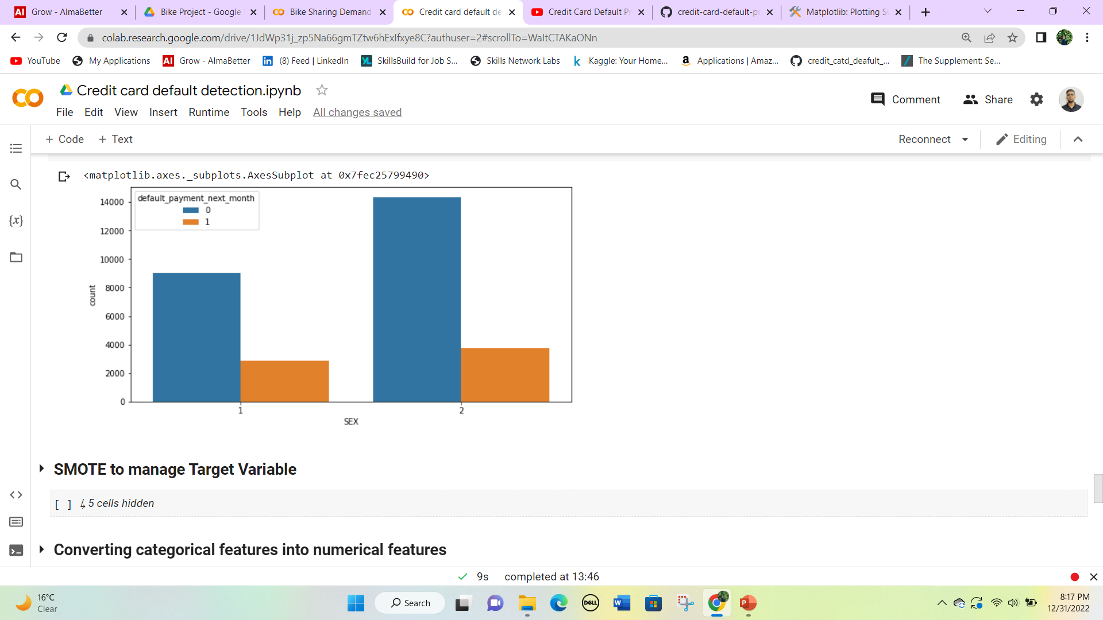
Gender v/s Target Variable
1 - Male
2 - Female
Number of Male credit holders is less than Females.
There are more female defaulters than males.

Slide 20
4. Feature Engineering
Feature engineering is the pre-processing step of machine learning, which is used to transform raw data into features that can be used for creating a predictive model using Machine learning or statistical Modelling.
First we will check the correlation between each variable.
Then we will transform our features for machine learning model building.

Slide 21
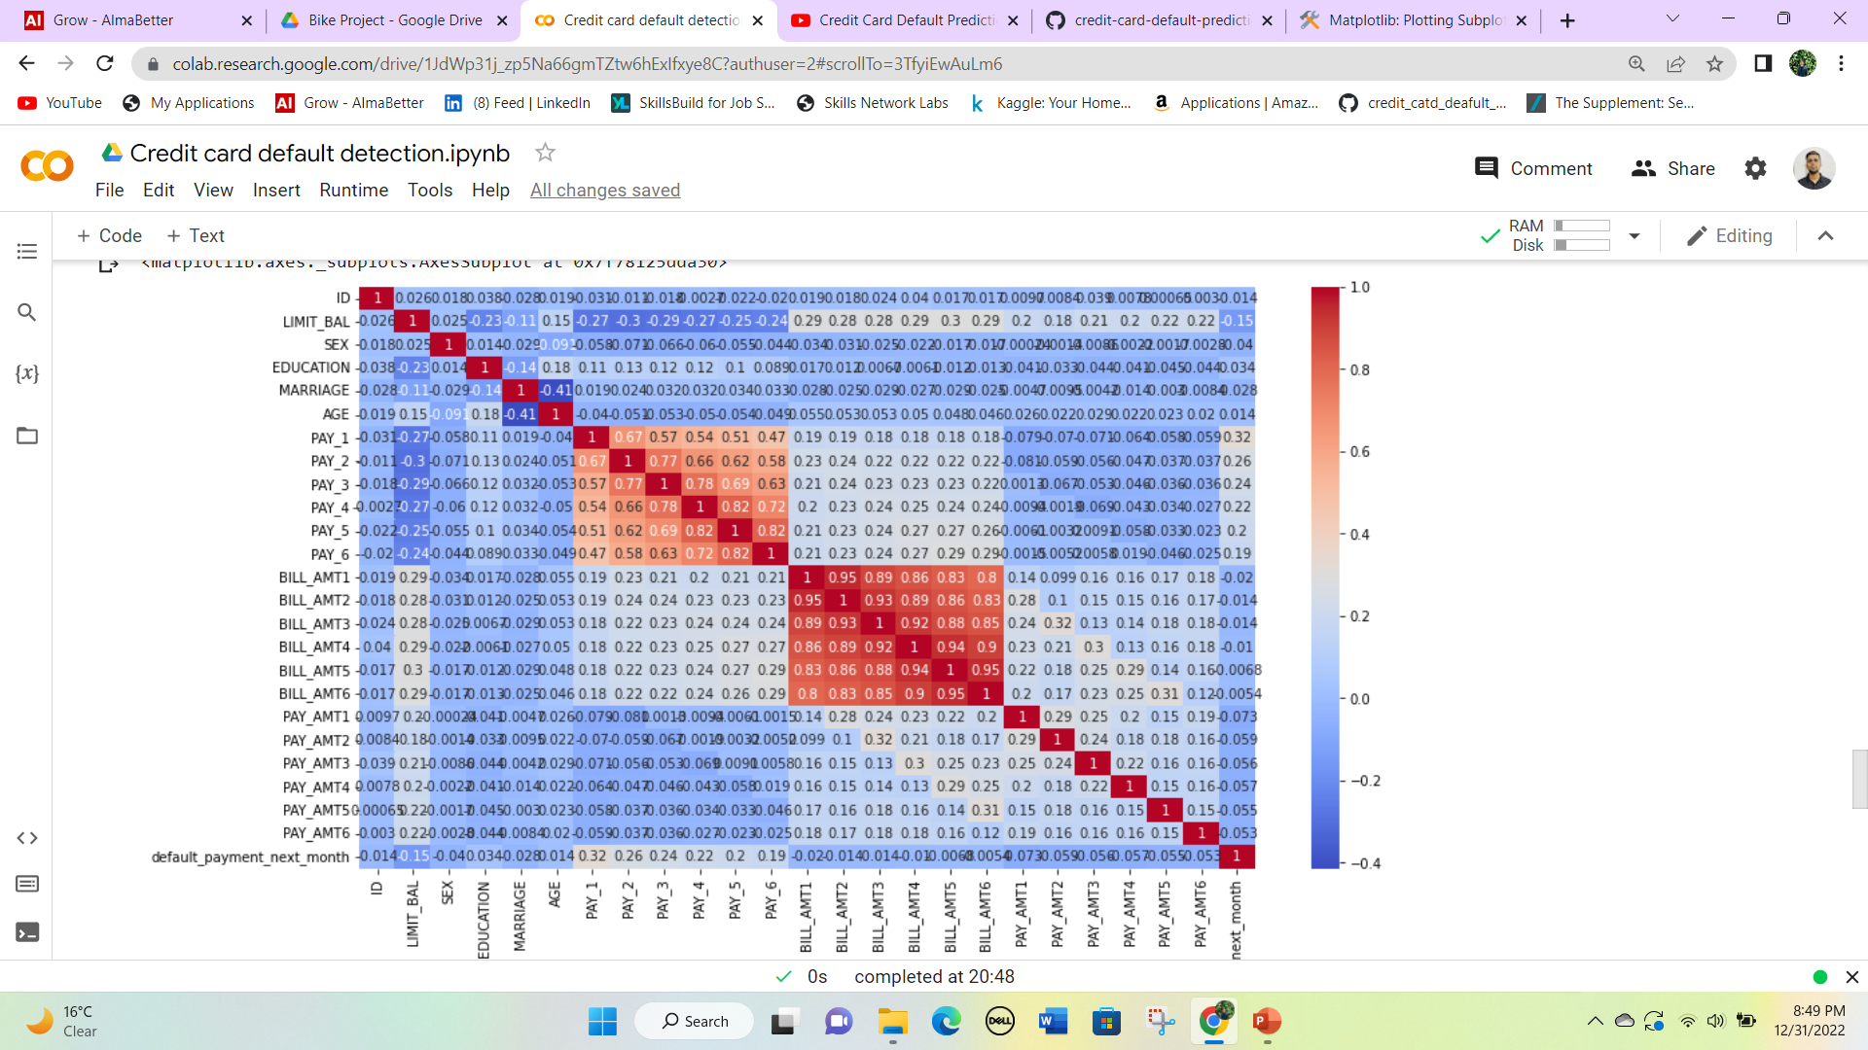
Correlation between variables
It seems from the above graph is there is some negatively correlated feature like age but we cannot blindly remove this feature because it could be an important feature for prediction.

Slide 22
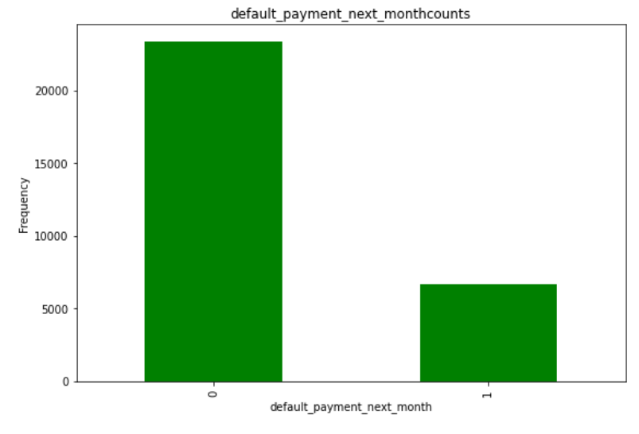
SMOTE to manage Target Variable
SMOTE (Synthetic Minority Oversampling Technique) – Oversampling is one of the most commonly used oversampling methods to solve the imbalance problem.
In our data set we have Imbalanced Data Distribution in our dependent variable, it generally happens when observations in one of the classes are much higher i.e. not defaulter, or lower than the other classes i.e. defaulter.

Slide 23
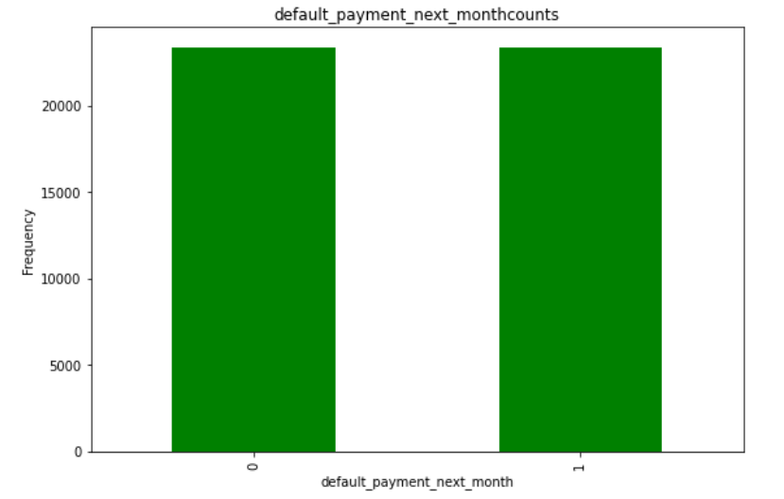
The data has been balanced and is ready for the last step of feature engineering. After that, all the process of dummy creation is done and the data is ready for model implementation.

Slide 24
5. Model Implementation
For the model implementation we have to do a test train split and we will train our model on 70% of the data to test the model we have taken 30% data.
We will find some metrics to check the performance of each model that will be:
Accuracy: Accuracy is the fraction of predictions our model got right.
Precision: Precision is a good metric to use when the cost of false positive(FP) is high.
Recall: Recall is a good metric to use when the cost associated with a false negative(FN) is high.
F1-score: The F1-score is a weighted average of precision and recall. Thus, it considers FP and FN. This metric is very useful when we have uneven class distribution, as it seeks a balance between precision and recall.

Slide 25
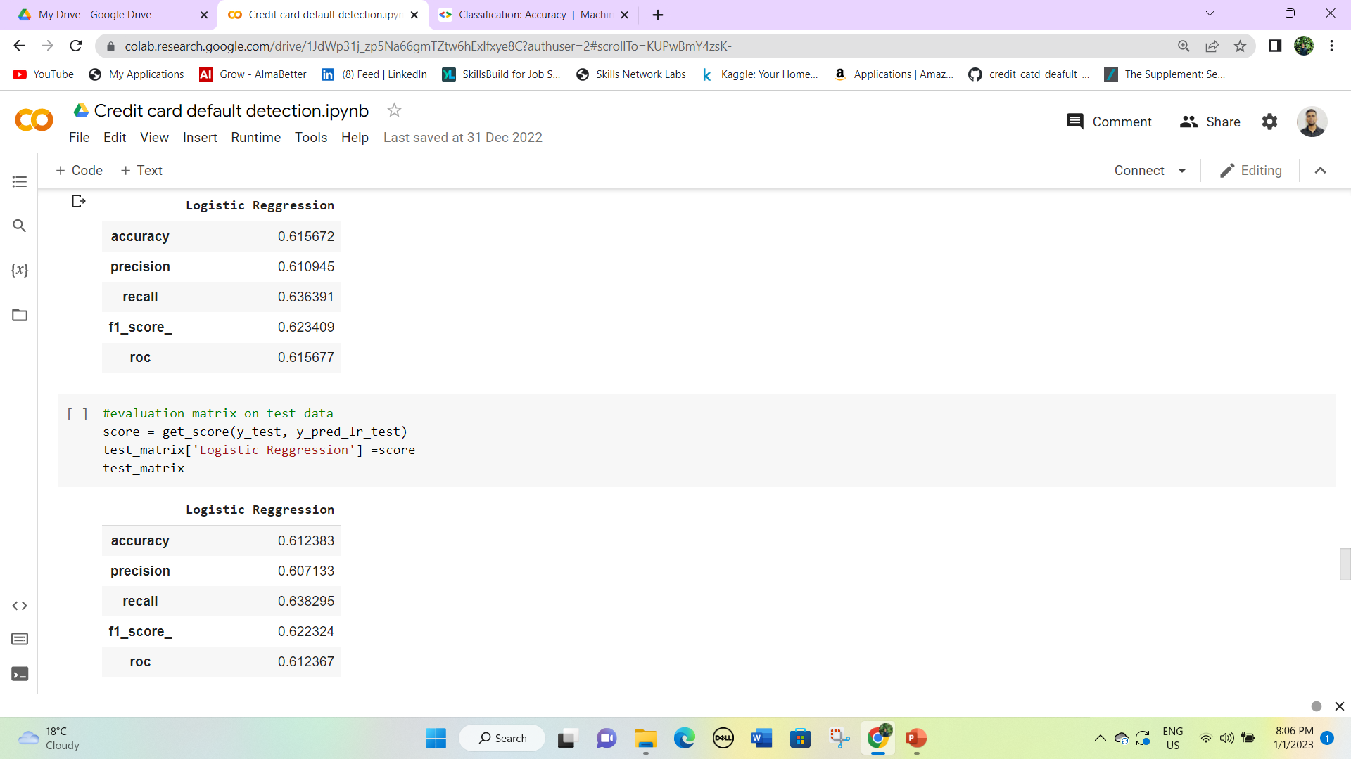
Logistic
The first one table is for train data and the below table is for test data.
Both test and train score is similar.
We have an accuracy of 61.23% on the test while on the train we have an accuracy of 61.56%. It means the model is working fine

Slide 26
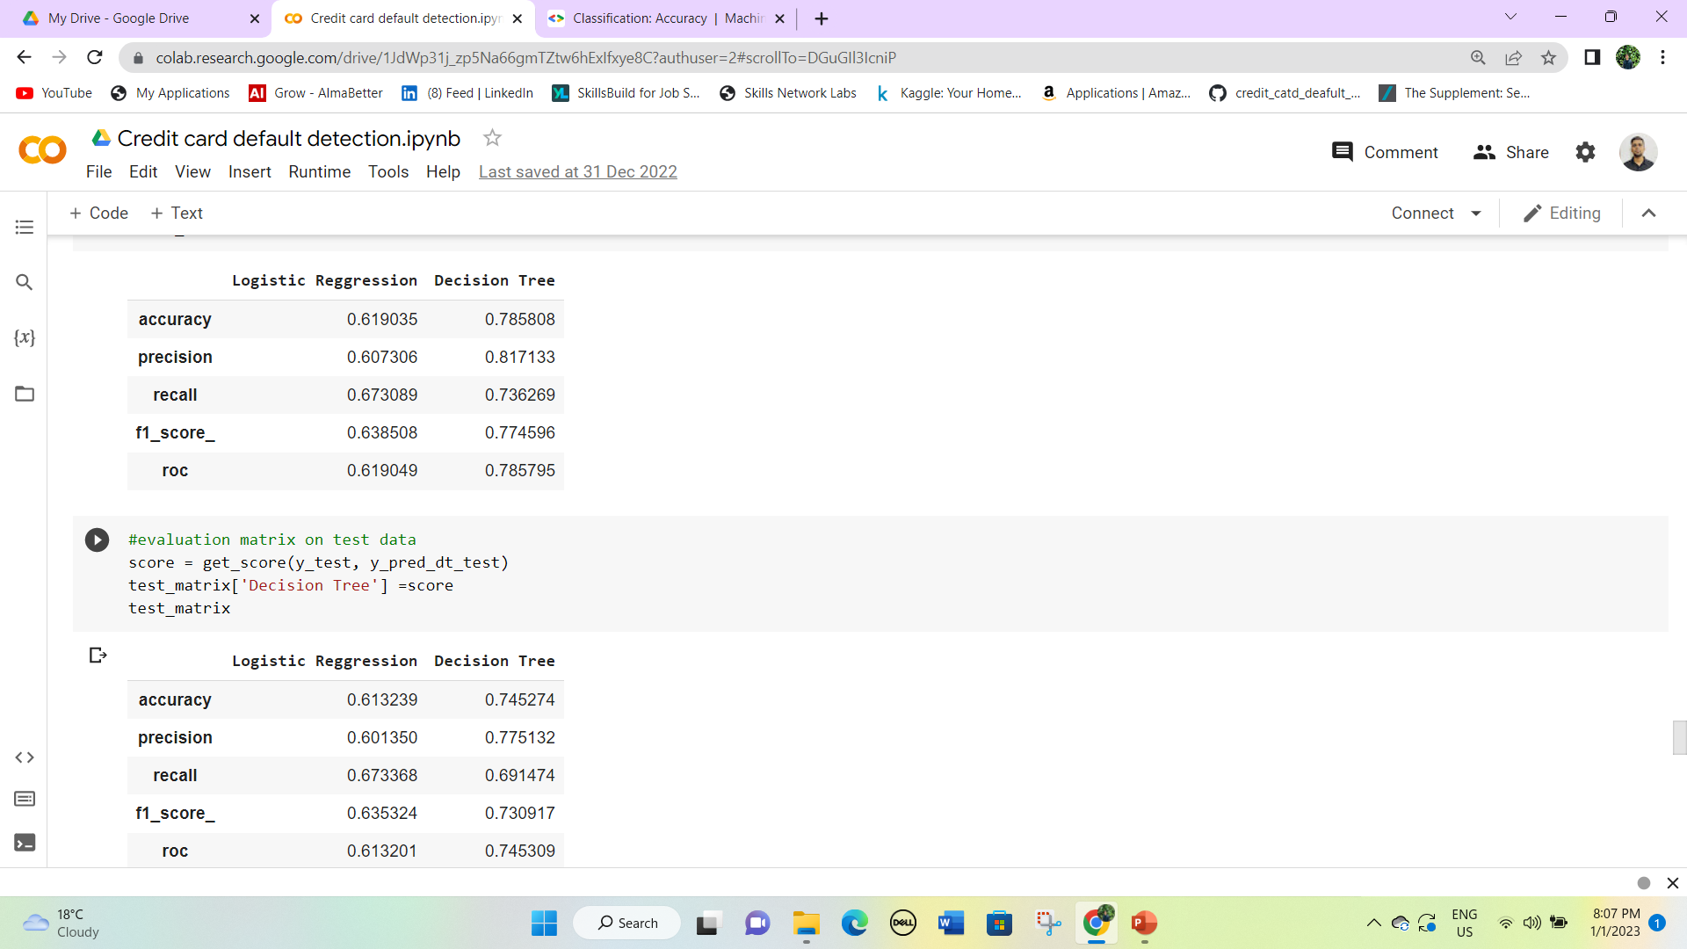
Decision Trees
In the decision trees classifier, the accuracy is more than in the logistic regression model.
The first table is for train data and the below table is for test data.
We have an accuracy of 78.58% on train data and 74..52% on the test data, which indicates that the model is performing well.

Slide 27
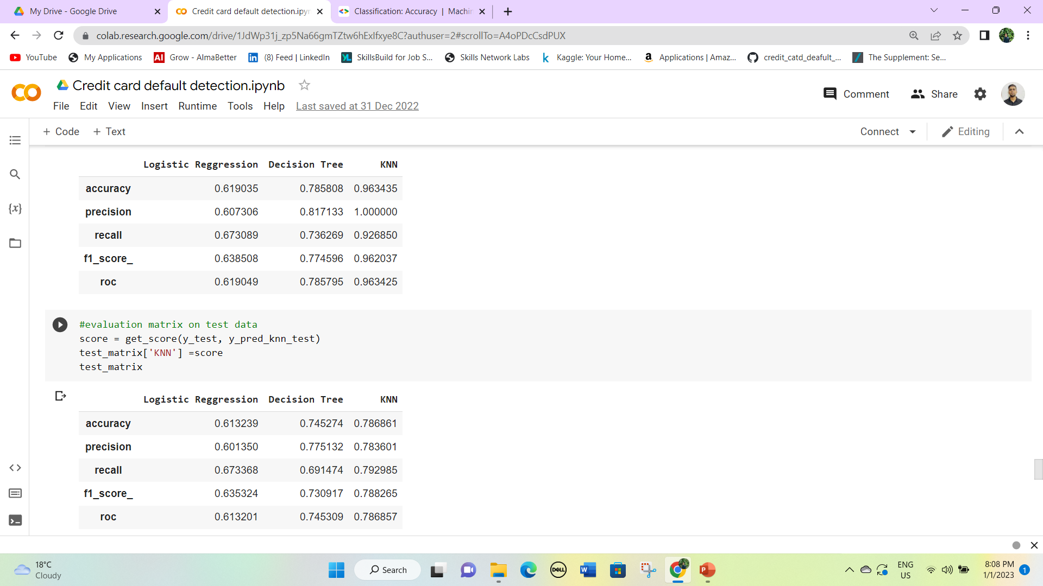
KNN Classifier
This KNN classifier model is best among all three logistic regression and decision tree and KNN classifier for train data.
The accuracy on train data is 96.34% while the accuracy on test data is only 78.68%, which indicates that the error in the test-train result is large and the model is not so good.

Slide 28
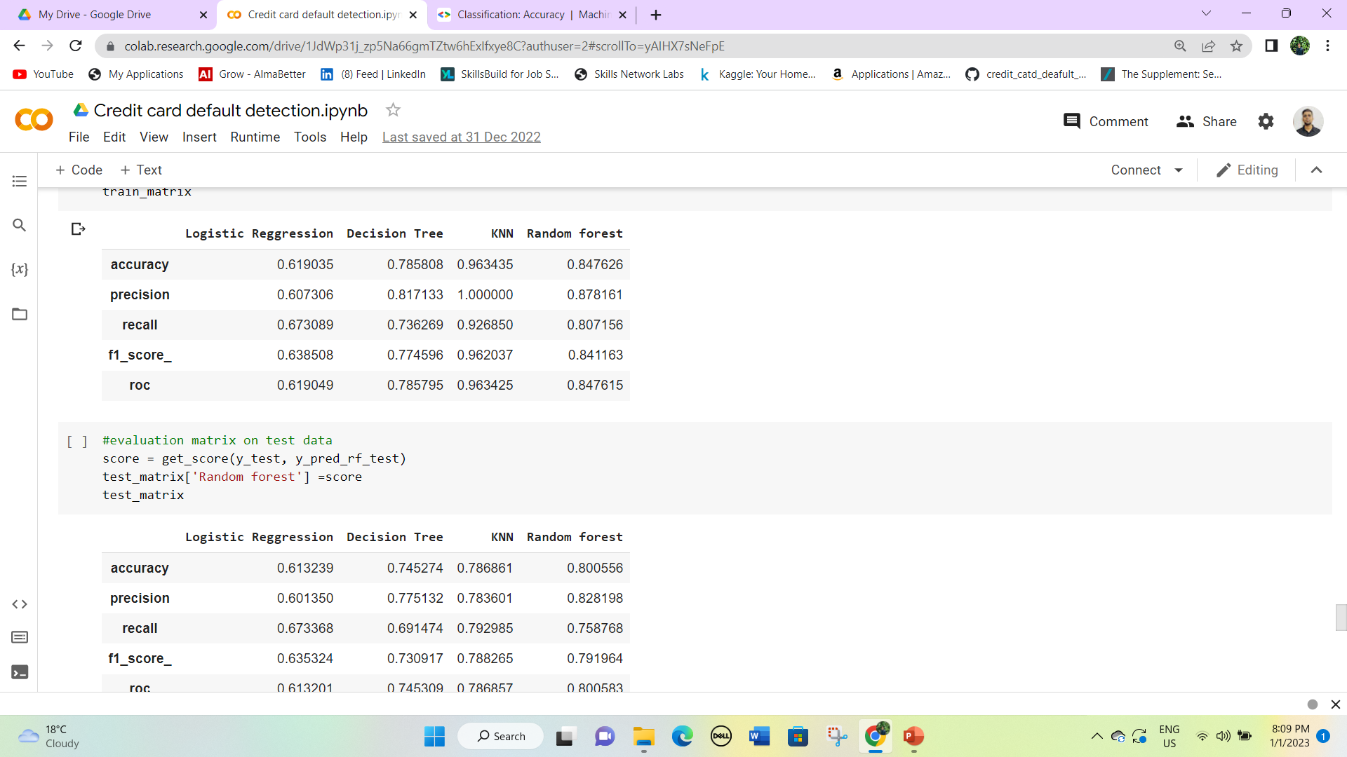
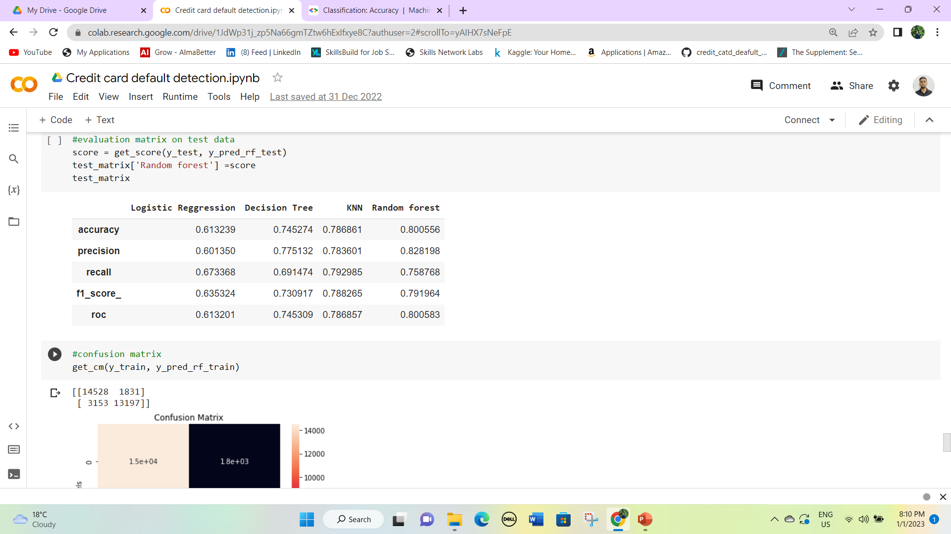
Random Forest Classifier
Random forest classifier has an accuracy of 84.76% on train data and 80.05% on test data.
It clearly indicates that the model is considering all feature importance and it working well.

Slide 29
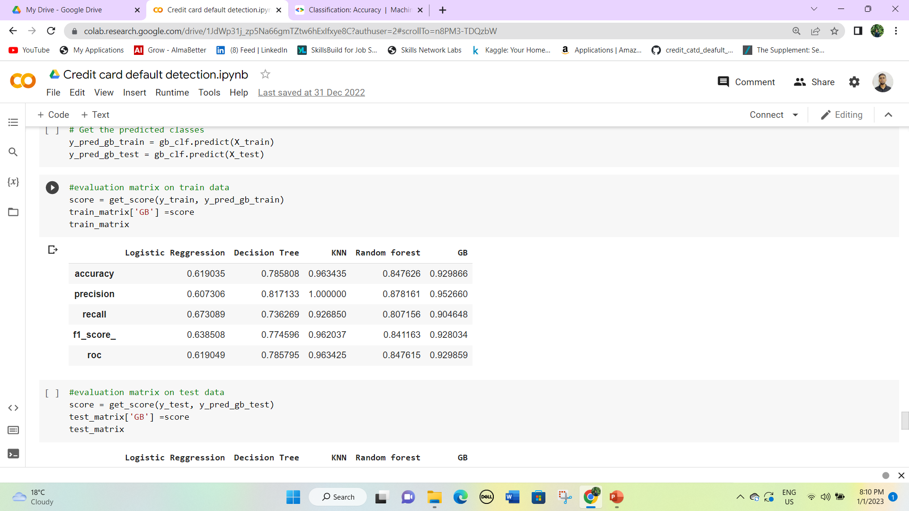
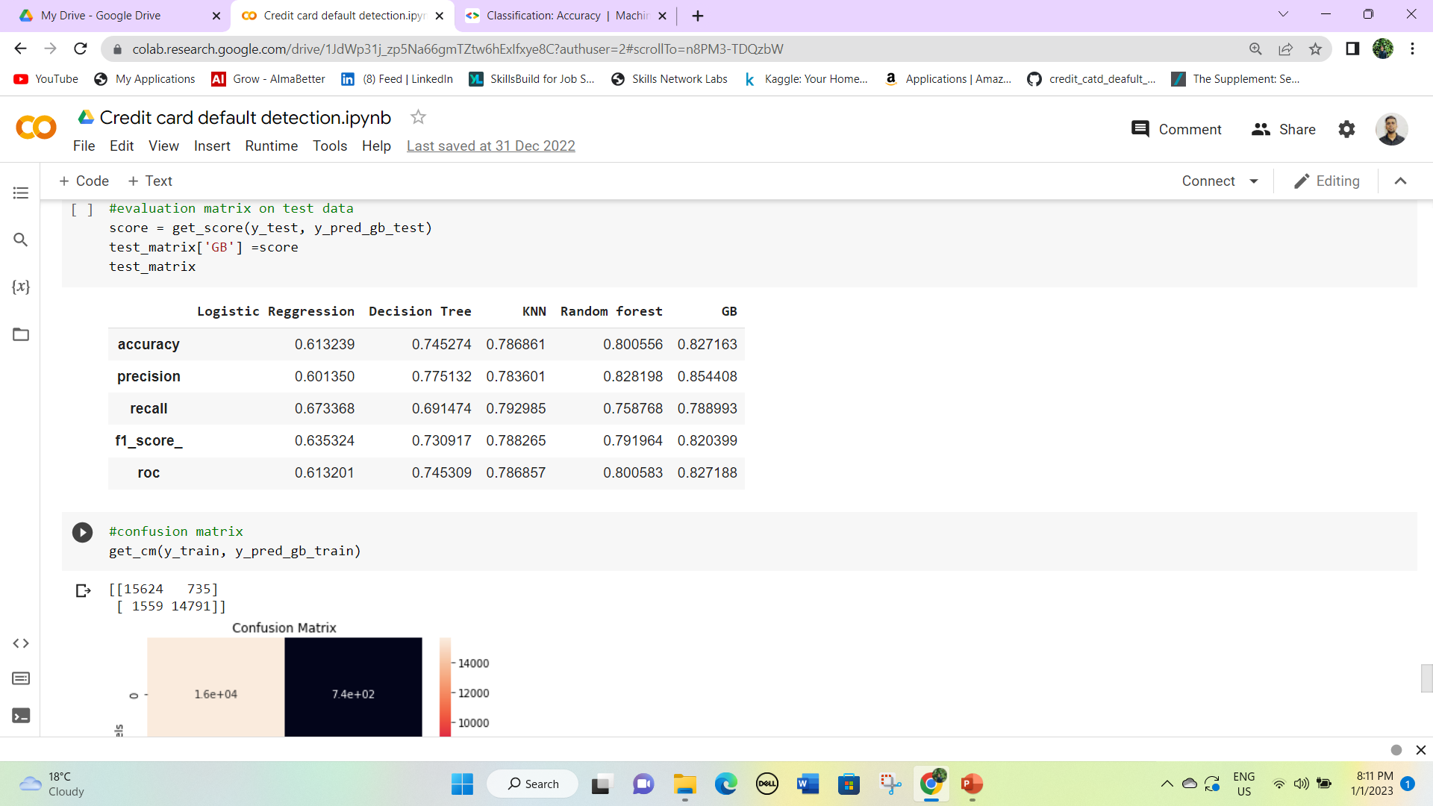
Gradient Boosting
Gradient boosting is the best method for test data because out of all models it has the highest precision on test data.
Though it has an accuracy of 92.98% on test data which is less than the KNN classifier but on test it works best.

Slide 30
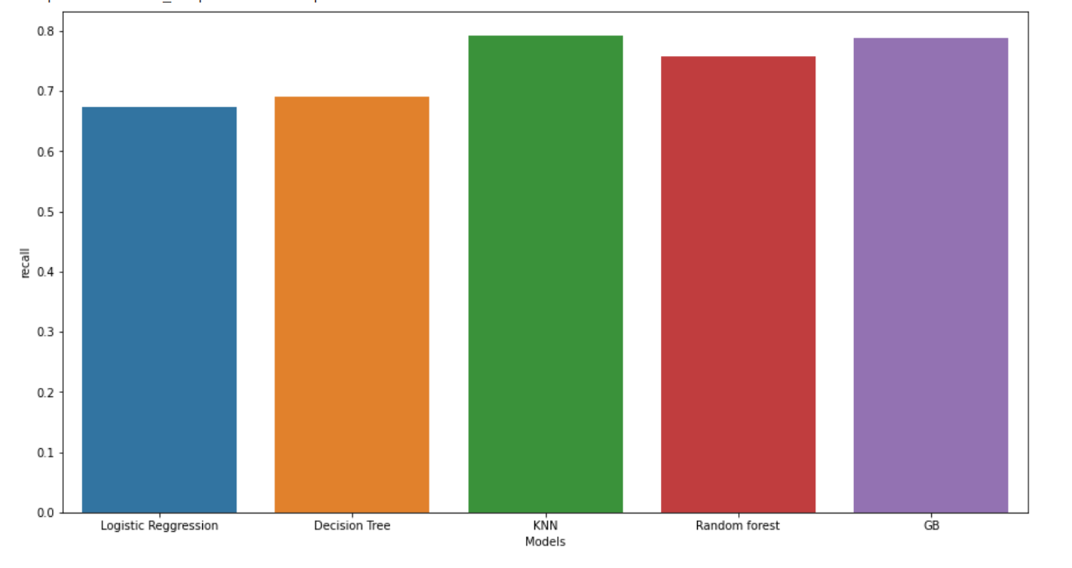
6. Model Explainability
We have implemented five different models for this classification project and out of all gradient boosting has the best accuracy.
Now let’s visualize the accuracy using a bar graph.

Slide 31
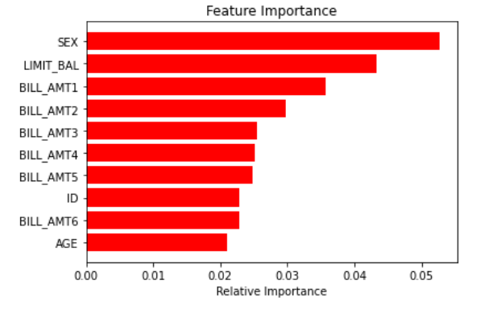
Feature Importance
We can clearly see that the gender of a person and limit balance is the most significant feature in the dataset.
Bill amounts also play a crucial role in indicating whether a person will have a default payment next month or not.

Slide 32
Conclusion
All the performance values of each model are given on the test dataset.
The Logistic classifier has an accuracy of 61.2%
The Decision Tree has an accuracy of 74.52%
The Random Forest has an accuracy of 78.68%.
KNN classifier model has an accuracy of 80%
XG Boost has an accuracy of 82.71% which is the highest of all models.
I can clearly say that XG Boost is the best and all performance metrics are the highest among all models.

